Slide 1
Self-introduction
Zhang Pengjie（张鹏杰）
School of Computer Science & Technology, BIT

Slide 2
1
Introduction
2
Honors
3
Conclusion

Slide 3

Part One ▷▷
Introduction
Personal Information
My Hometown
Educational Experience

Slide 4
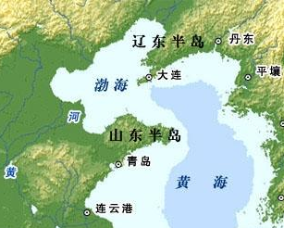

Personal Information
Name：Zhang Pengjie（张鹏杰）
HomeTown：ShanDong Province（山东）
(1) Located in the Bohai Rim（环渤海地区）
(2) Facing the Liaodong Peninsula （辽东半岛）across the sea

Slide 5
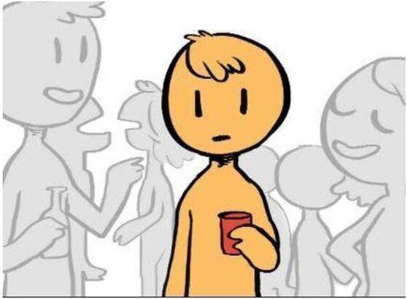
Personal Information
Name：Zhang Pengjie（张鹏杰）
HomeTown：ShanDong Province（山东）
(1) Located in the Bohai Rim（环渤海地区）
(2) Facing the Liaodong Peninsula （辽东半岛）across the sea
Personality：Introvert and a bit extrovert

Slide 6
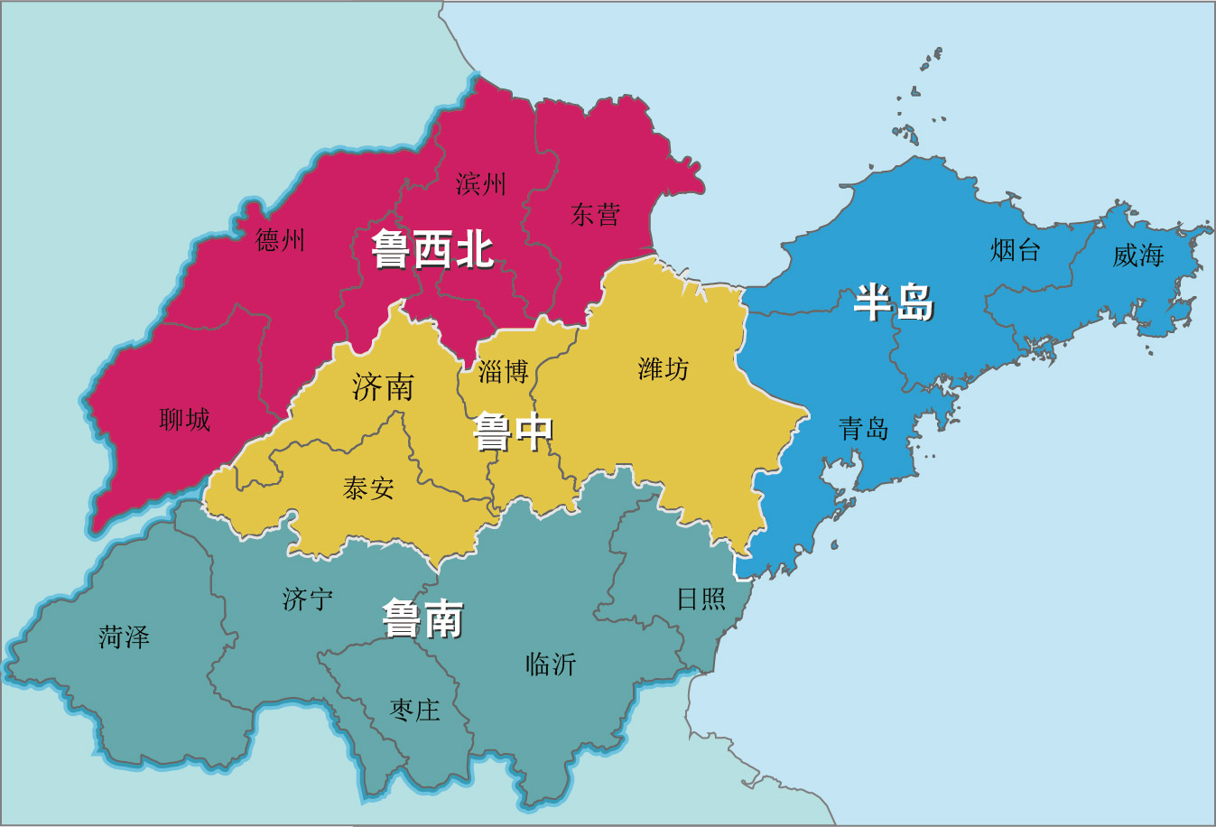
My Hometown
Divided into four parts:
Sorthwest
Central
Jinan(济南): The capital of Shandong
Weifang(潍坊)：My Hometown
Zibo(淄博): Emerging tourist city
Taian(泰安): The Mount Taishan（泰山）
South
Jining(济宁)：The Confucian Temple（孔庙）
RiZhao(日照): Great place to see the sea
Peninsula region
Qingdao(青岛): The economic center of
Shandong

Slide 7
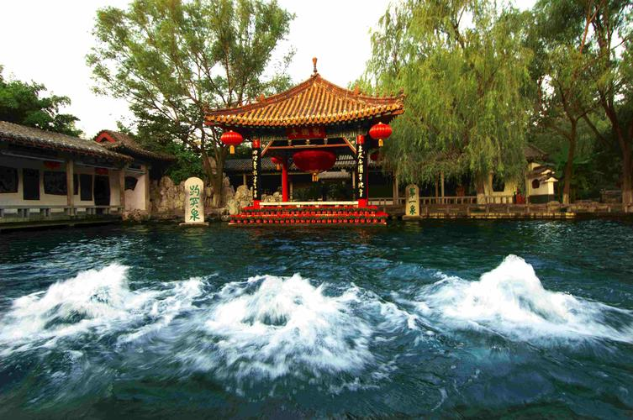
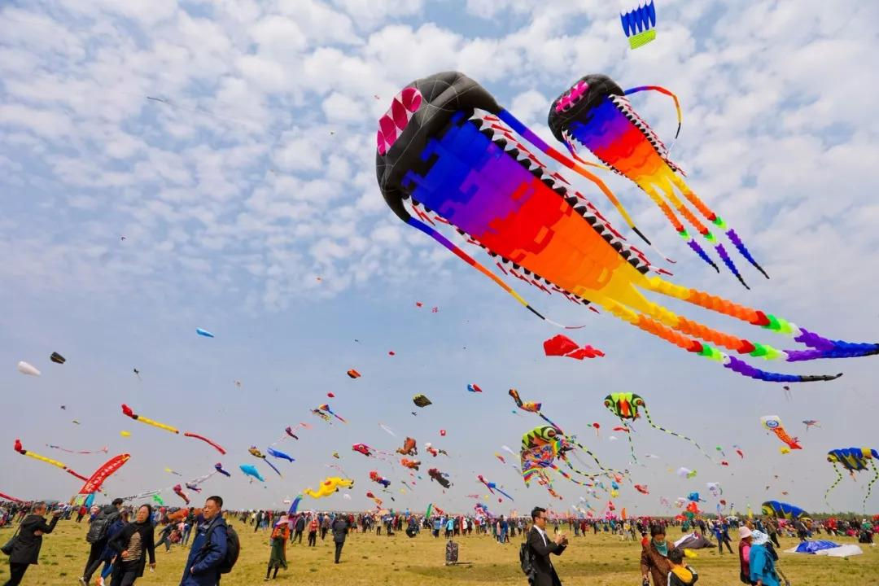
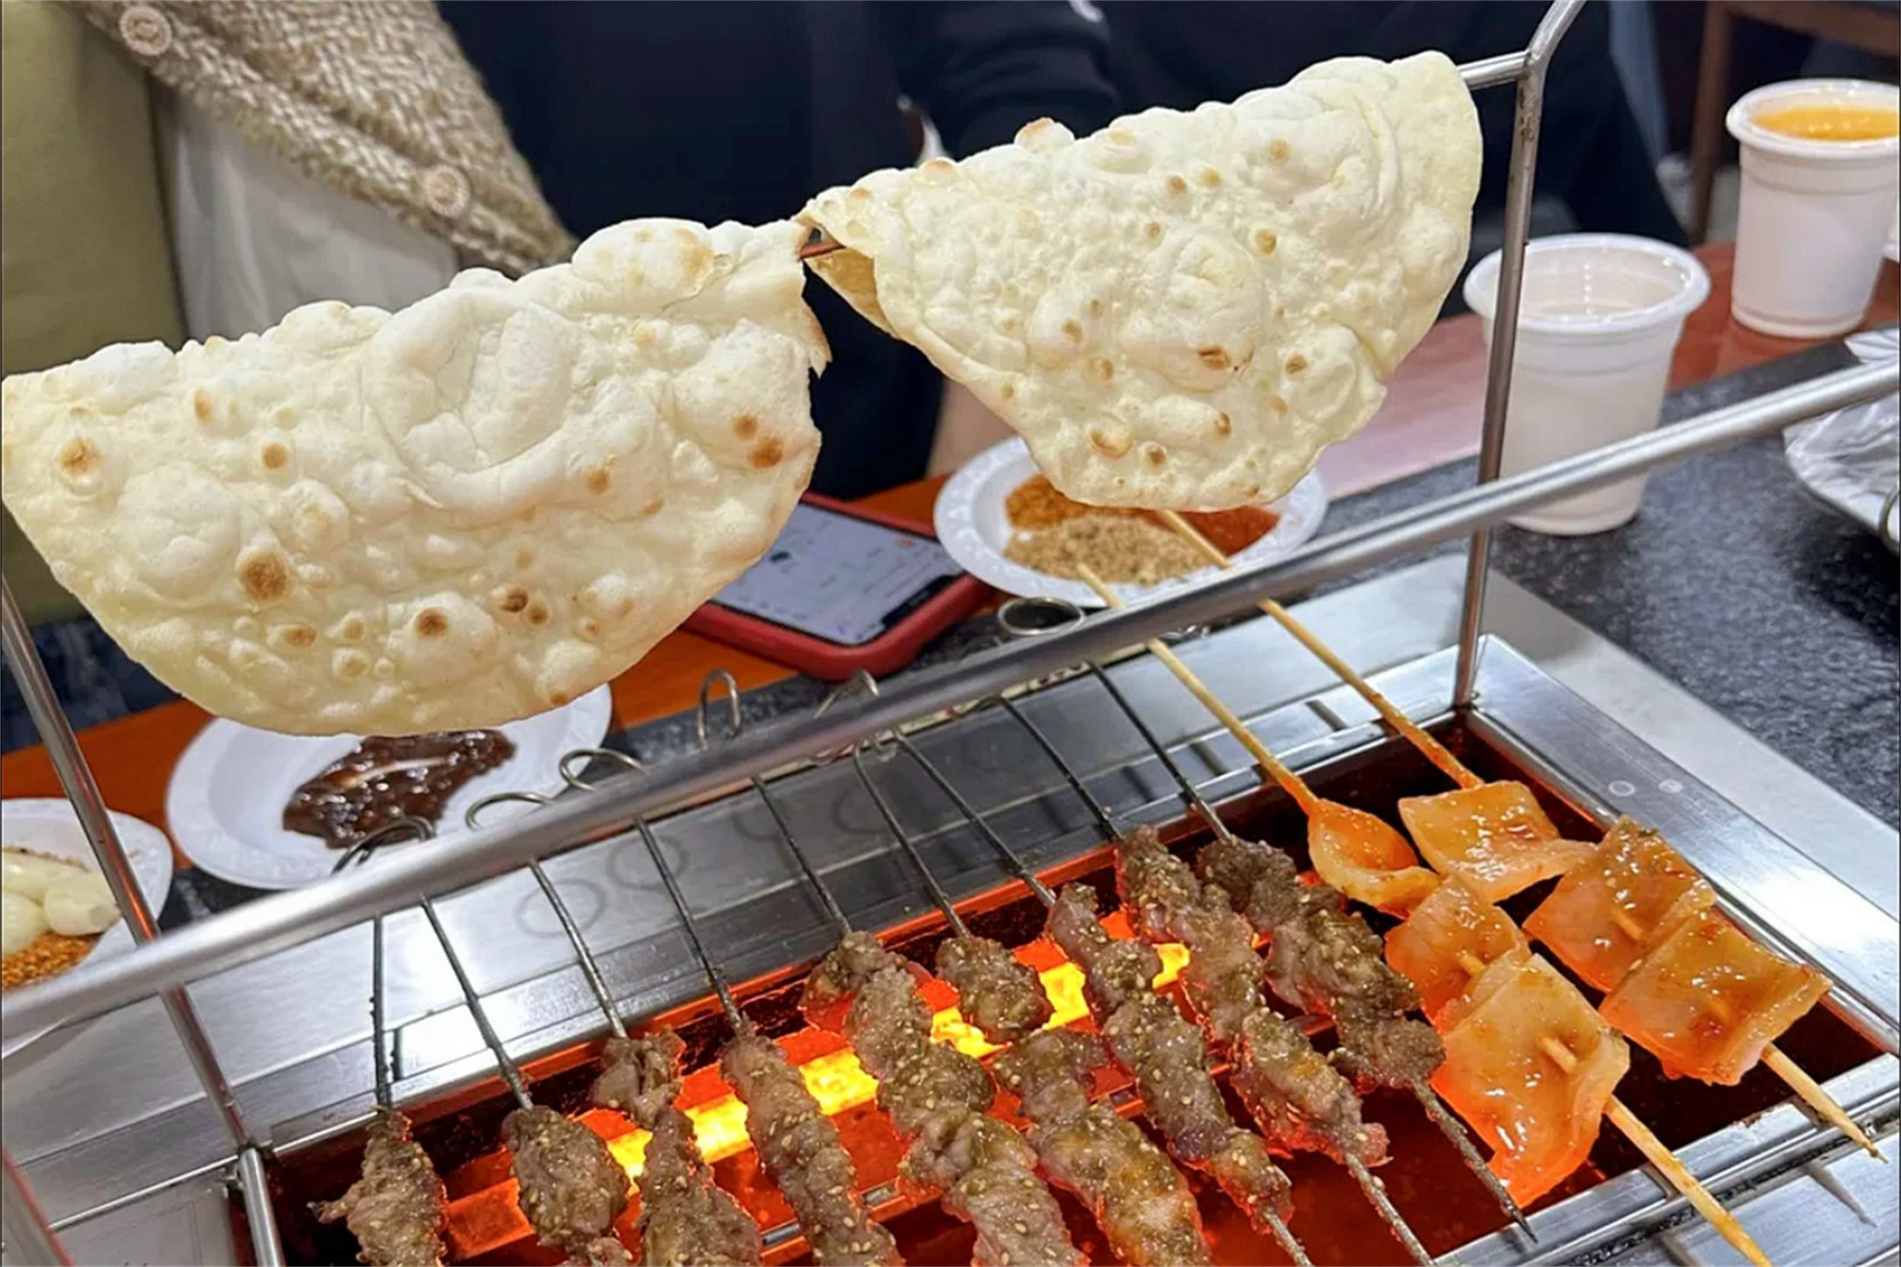
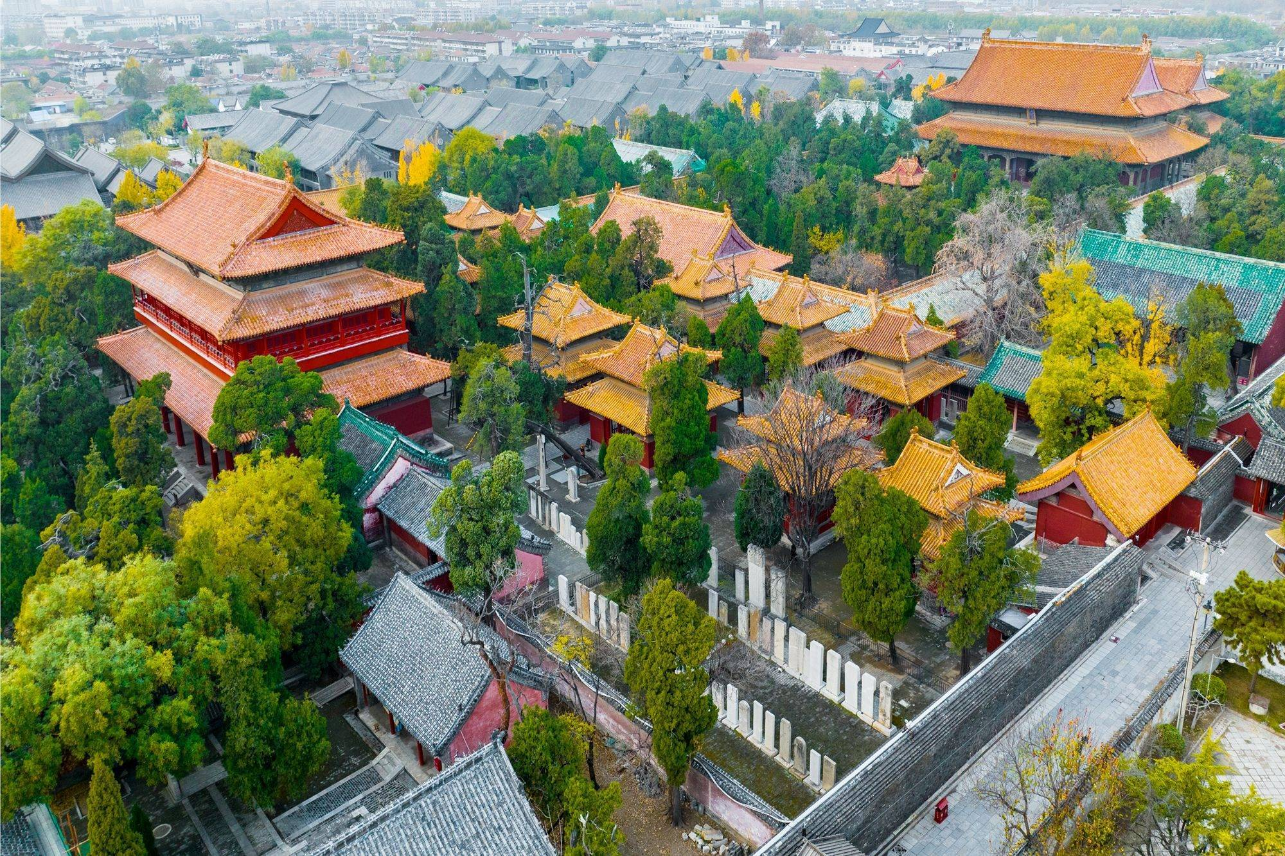
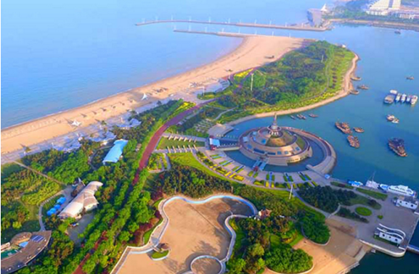
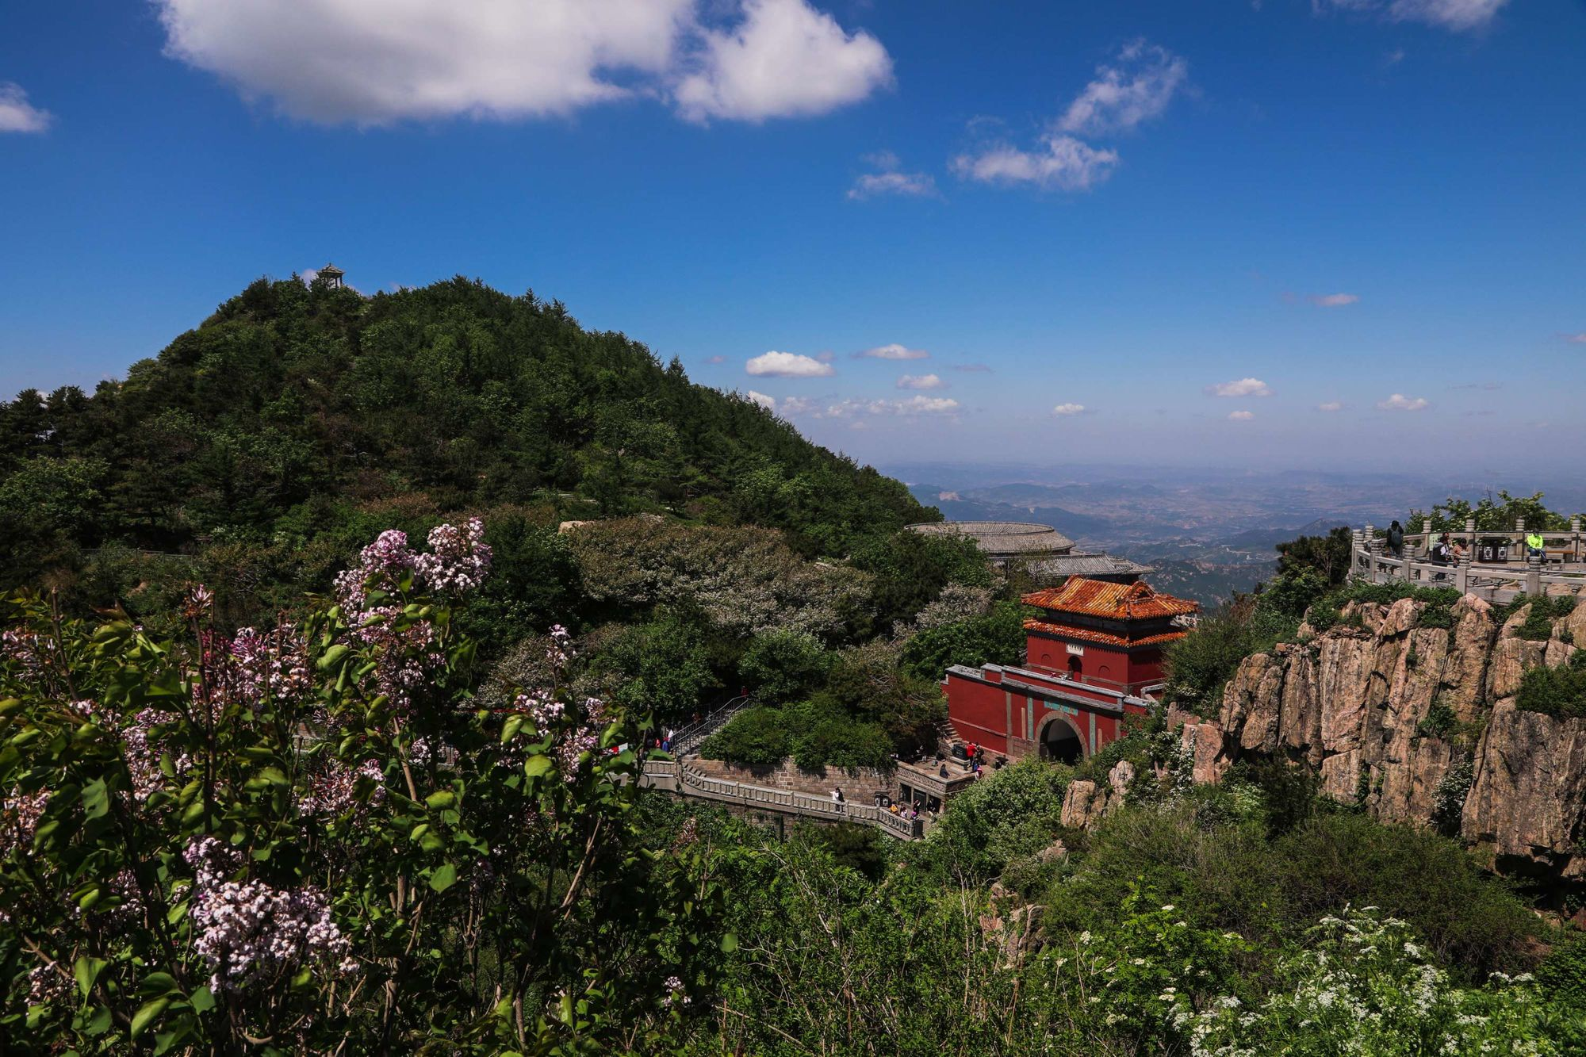
My Hometown
Jinan(济南)：Baotu Spring
Weifang(潍坊)：Kite Festival
Zibo(淄博): Barbecue
Jining(济宁)：The Confucian Temple
RiZhao(日照): Beachside resort
Taian(泰安)：Mount Taishan(泰山)

Slide 8
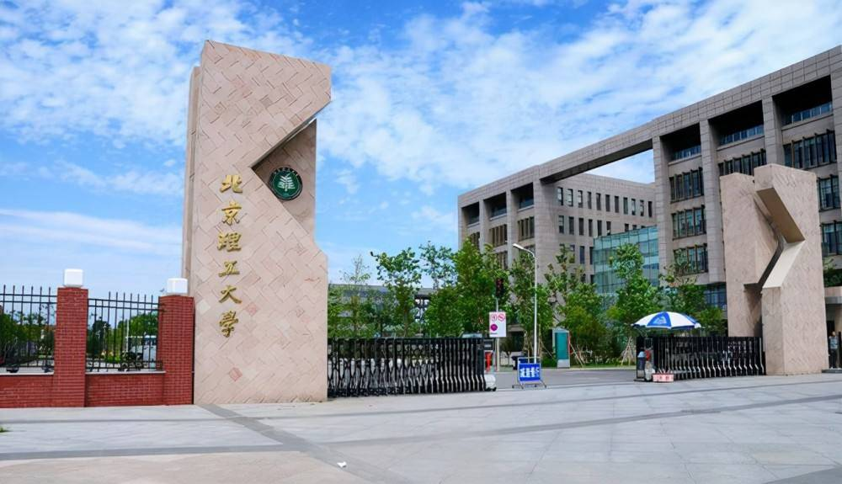
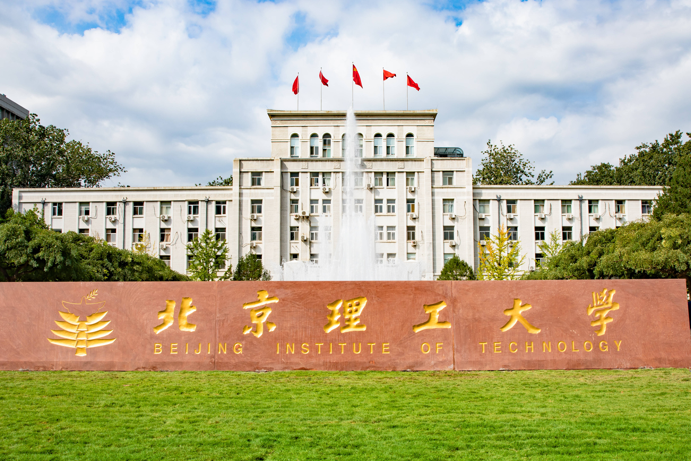


Educations
I have been studying at Beijing Institute of Technology for nearly 5 years since 2019.
I used to study for my undergraduate degree at Ruixin Academy of classic learning, but now I am pursuing a master's degree at the School of Computer Science & Technology.
My major is computer science and technology, and my main research direction is computer vision.
2019-2023
2023-至今

Slide 9
Part Two ▷▷
Honors
Honors

Slide 10
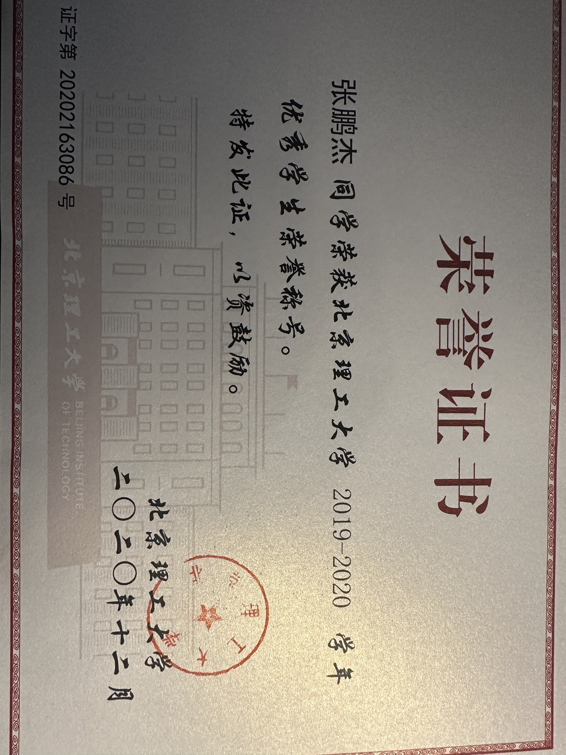
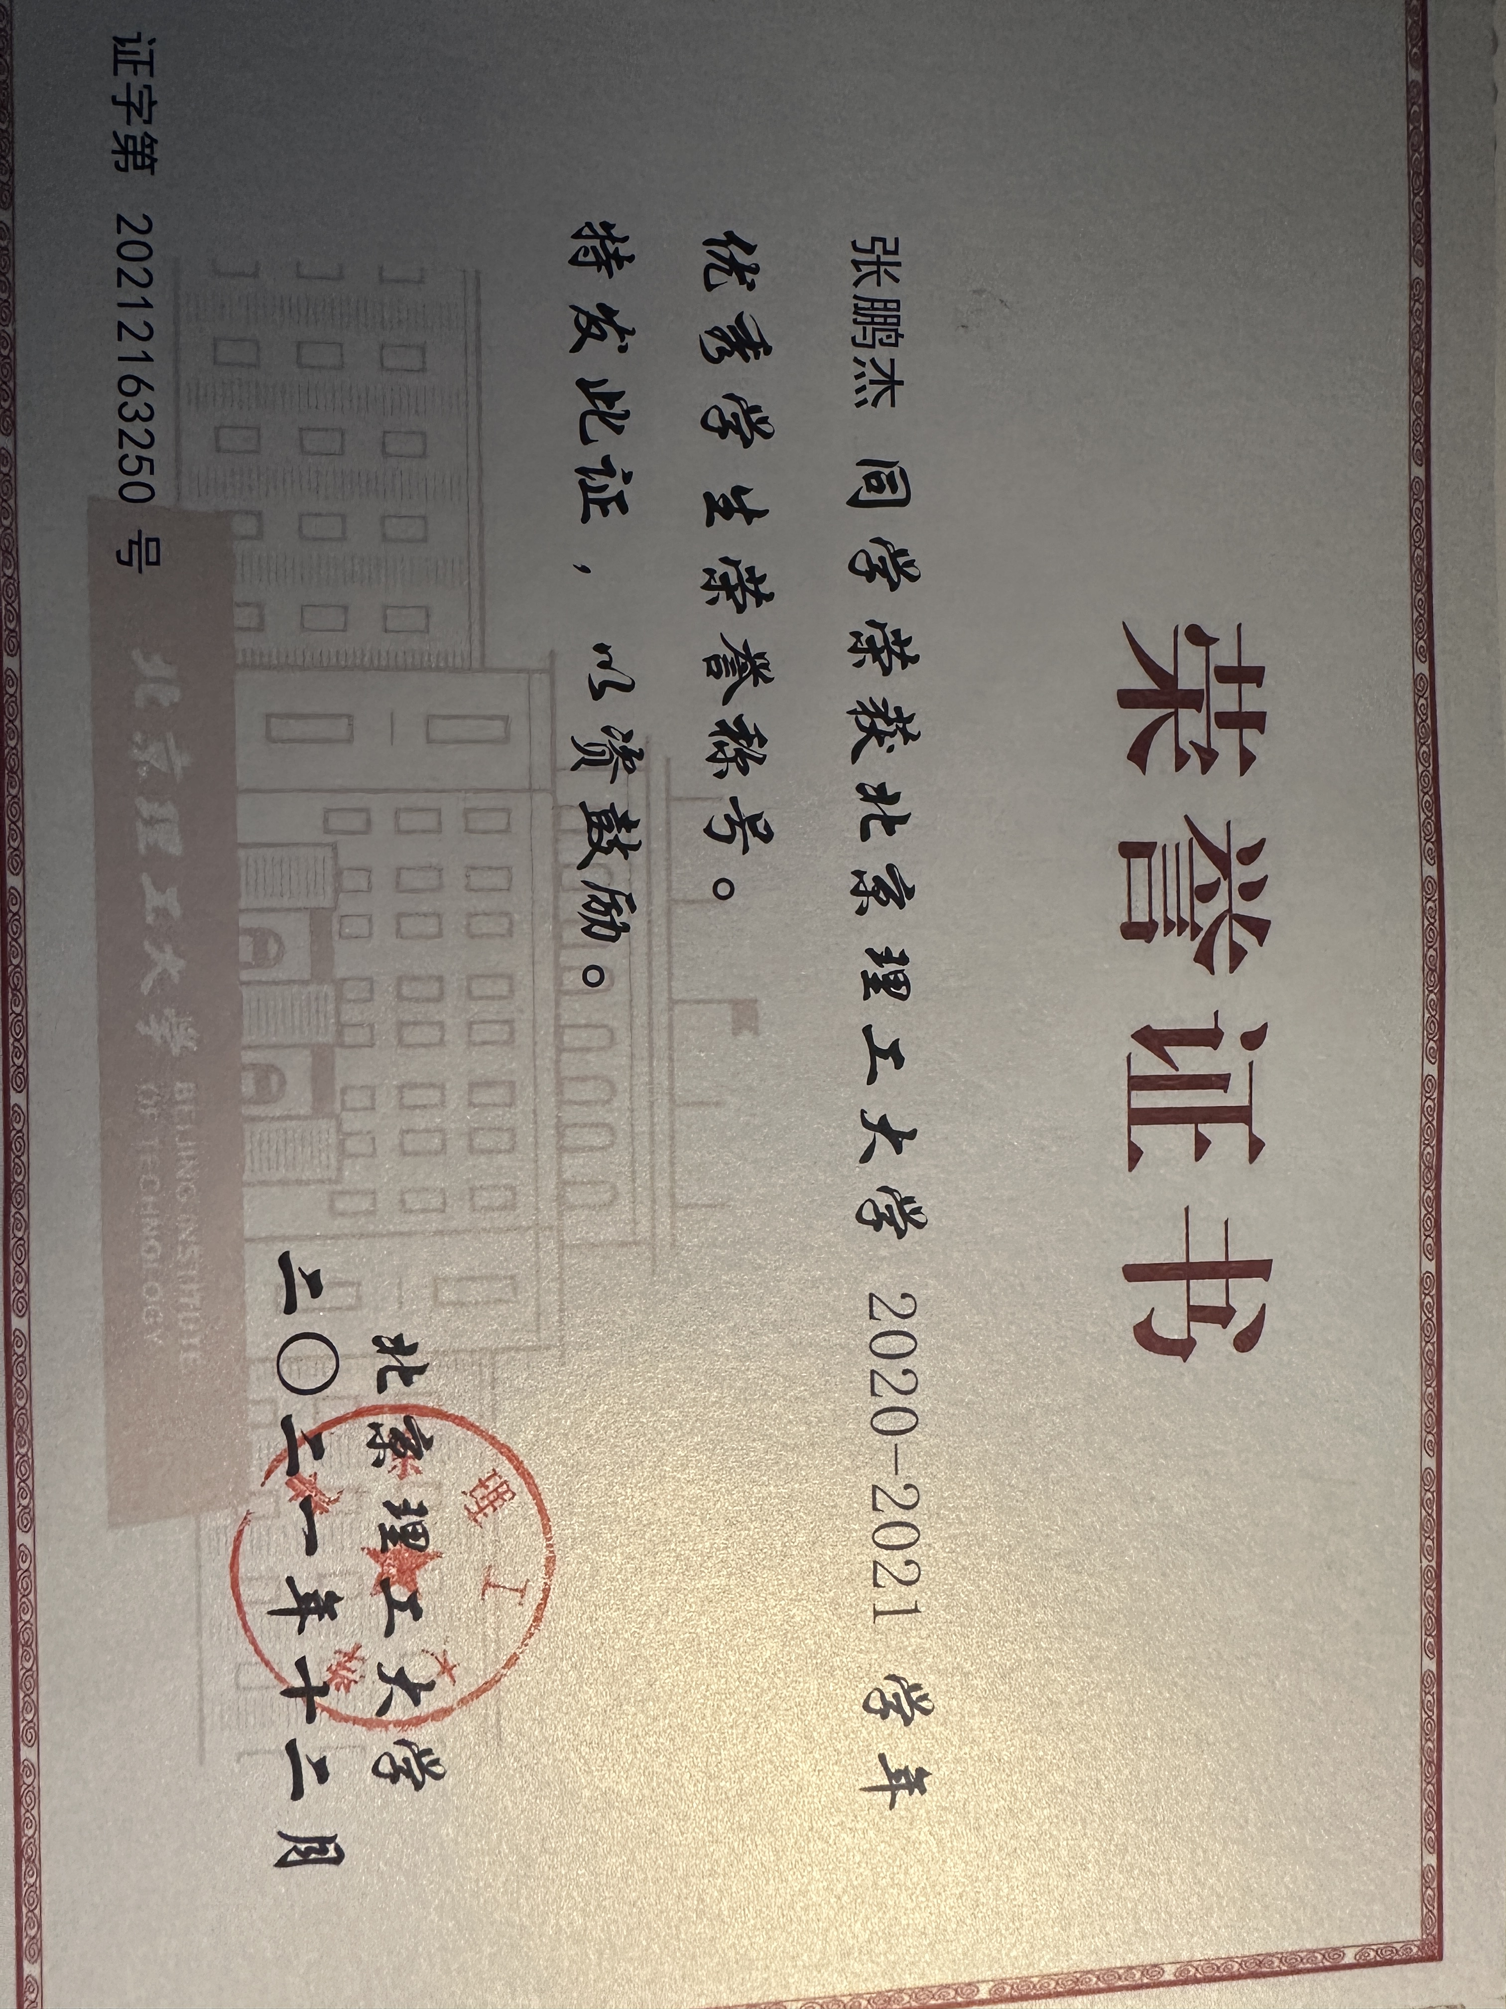
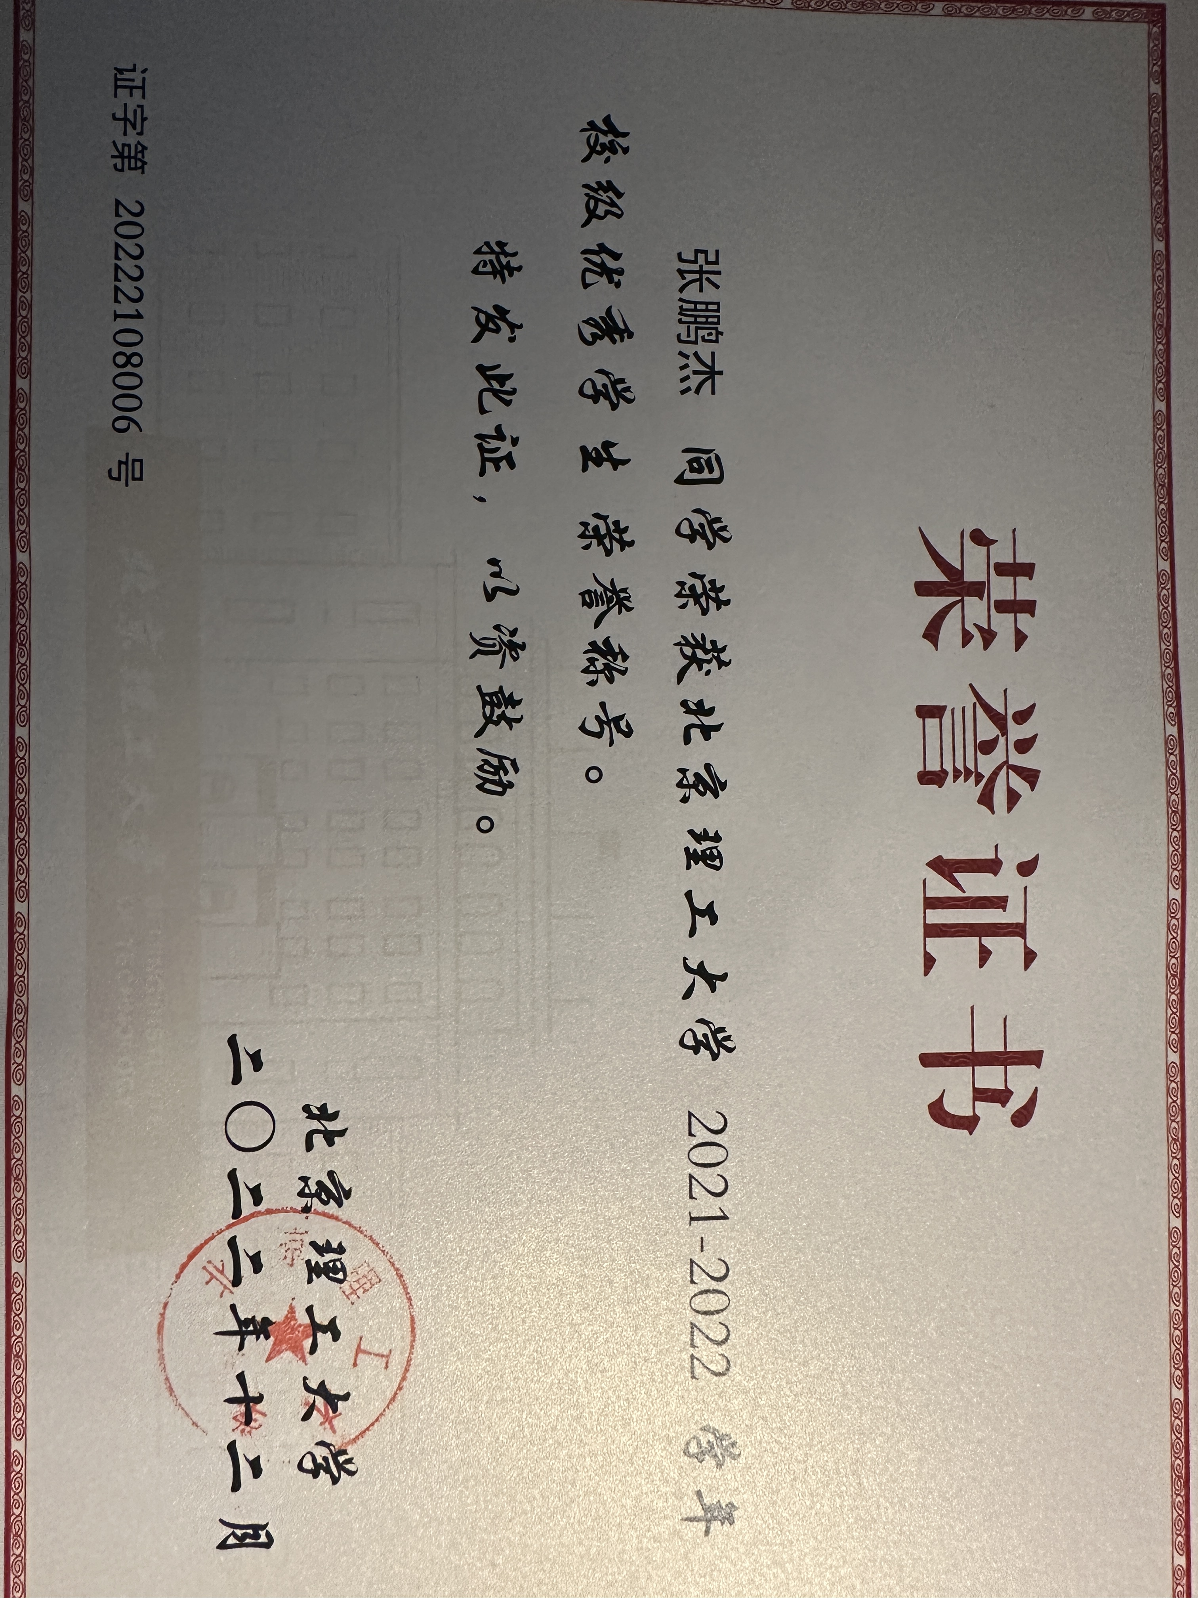
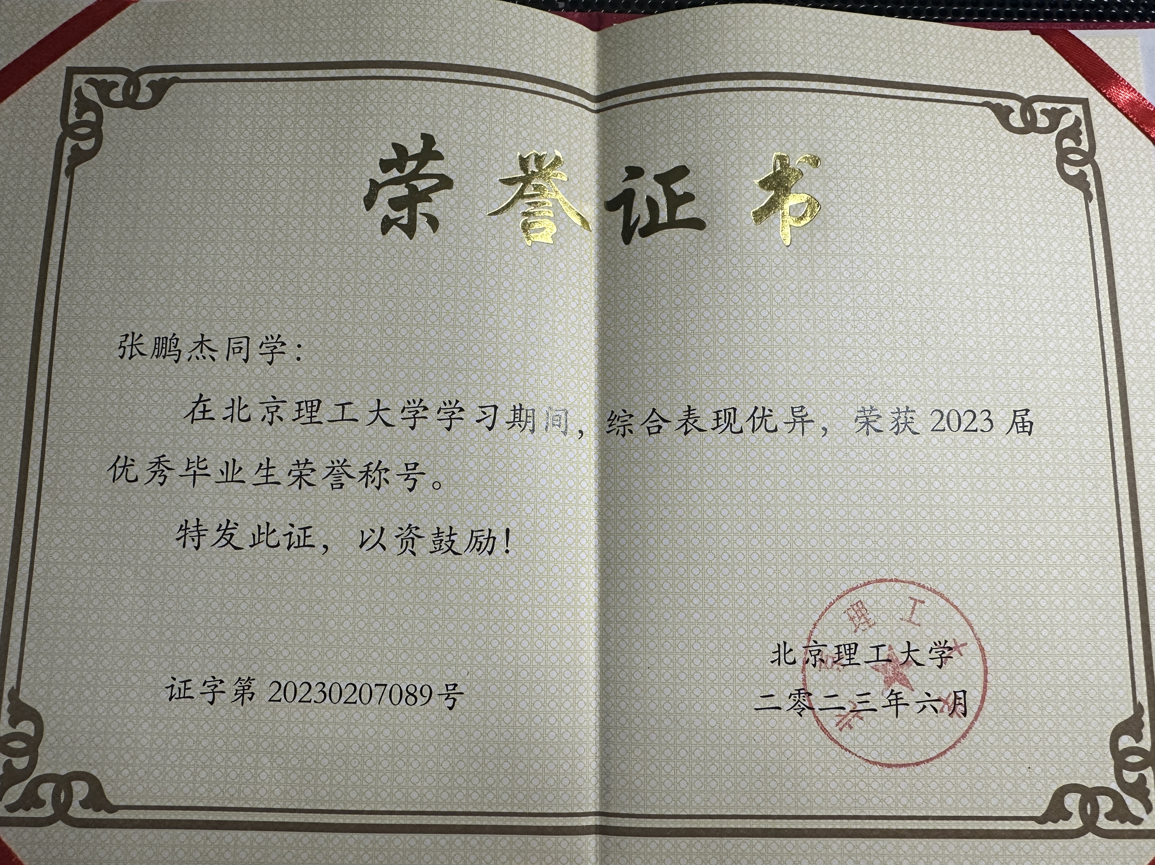
Honors
2019-2020
2020-2021
2021-2022
During my undergraduate studies, I was encouraged by school every year.
And in the final year, I was honored as an outstanding graduate, which at least proves that I have attended classes seriously during my undergraduate studies.

Slide 11
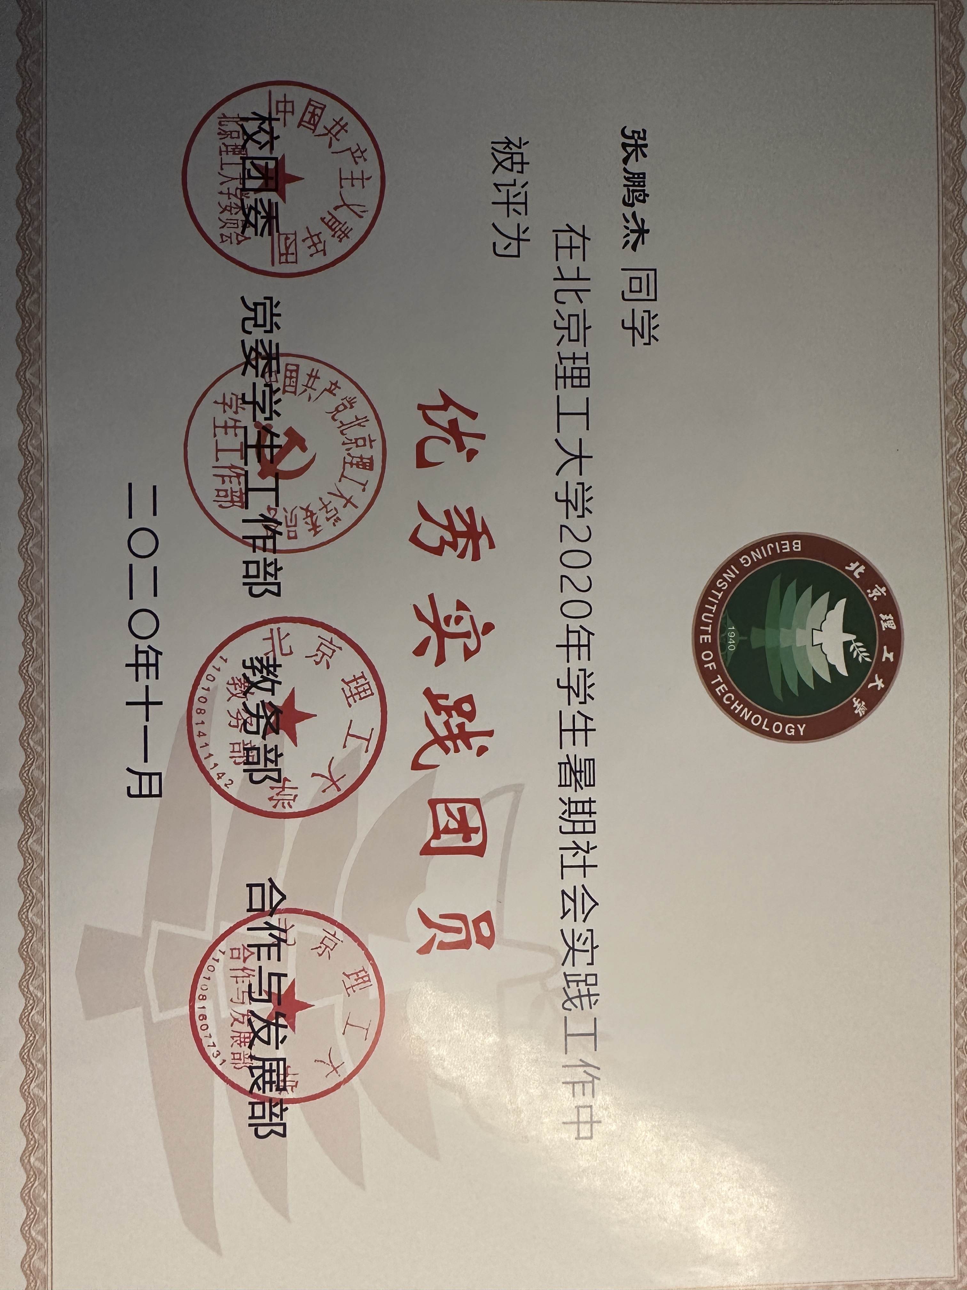
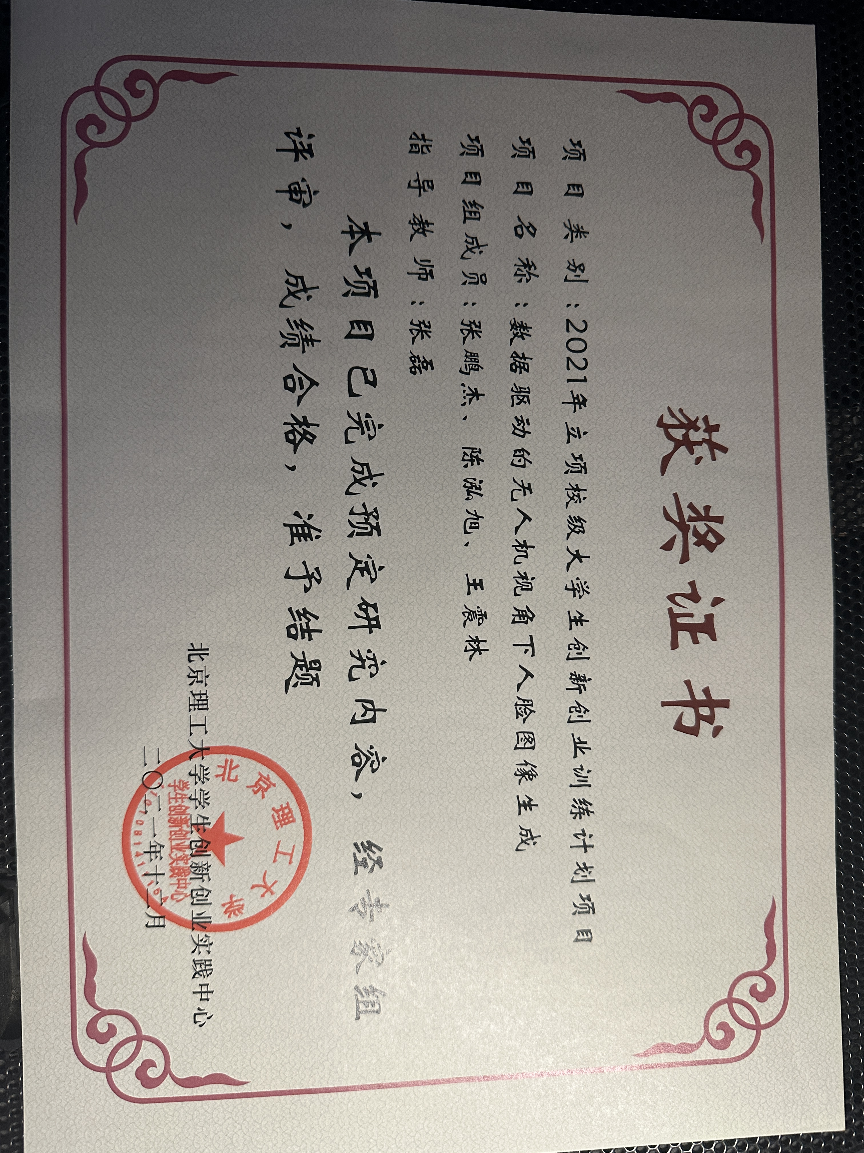
Honors
I have also teamed up to participate in social practice and innovative research.
Social Practice
Innovation research
We investigated the market organization structure in my hometown.
We studied facial image generation from low altitude perspectives.
Finally, we were rated as excellent practice team members
Finally, we successfully concluded the project.

Slide 12
Part Three ▷▷
Conclusion
Life Attitude

Slide 13
Life Attitude
All phenomena are like a dream, an illusion, a bubble and a shadow.
一切有为法，如梦幻泡影。
Like dew and lightning.
Thus should you meditate upon them.
如露亦如电，应作如是观。

Slide 14
Thanks for Listening
Presenter: Zhang Pengjie
（张鹏杰）

